Slide 1

CICSIC AFRICA DIVISION 2026
INUA BUSINESS
Diagnose. Grow. Connect.
Kabarak University

Slide 2
7.4 Million
MSMEs in Kenya
70%
of Kenyan MSMEs fail
within 3 years
Not from lack of ambition but
from lack of the right tools

Slide 3

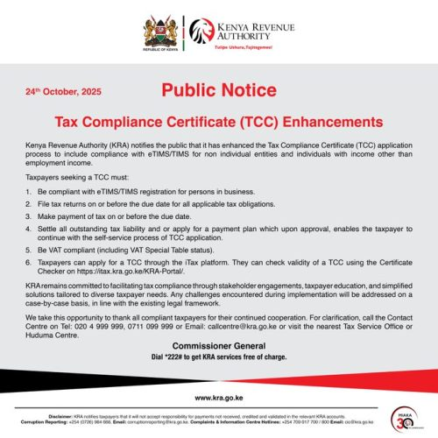


THE PROBLEM
Everyday thousands of Kenyan MSMEs are rejected by financers not because they lack potential, but because they cannot prove it
No Diagnostic Tools
Compliance Blind Spots
No structured way to measure business health
KRA, NHIF, NSSF, PAYE — invisible penalties
Capital Inaccessible
Fragmented Support
No investor-ready profiles = no funding
Training, mentors, funding exist separately
"The system isn't broken. It was never built for them."

Slide 4
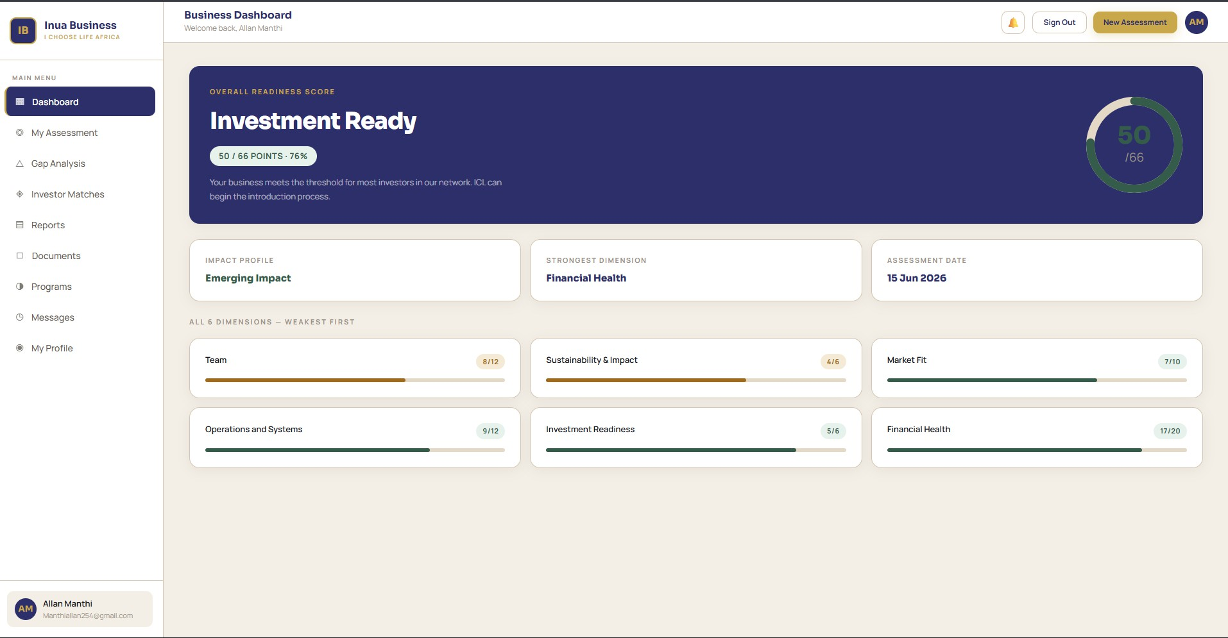
THE SOLUTION
A readiness platform that moves MSMEs from hidden and informal to visible, compliant and investor-ready.
Assess
10-step business health diagnostic
Learn
Personalized roadmaps +ICL Africa training pathways
Connect
ASSEK professional network, mentors, service providers
Grow
Investor & VC linkage
One platform. Four growth levers.
Built for Kenya. Designed for scale.

Slide 5
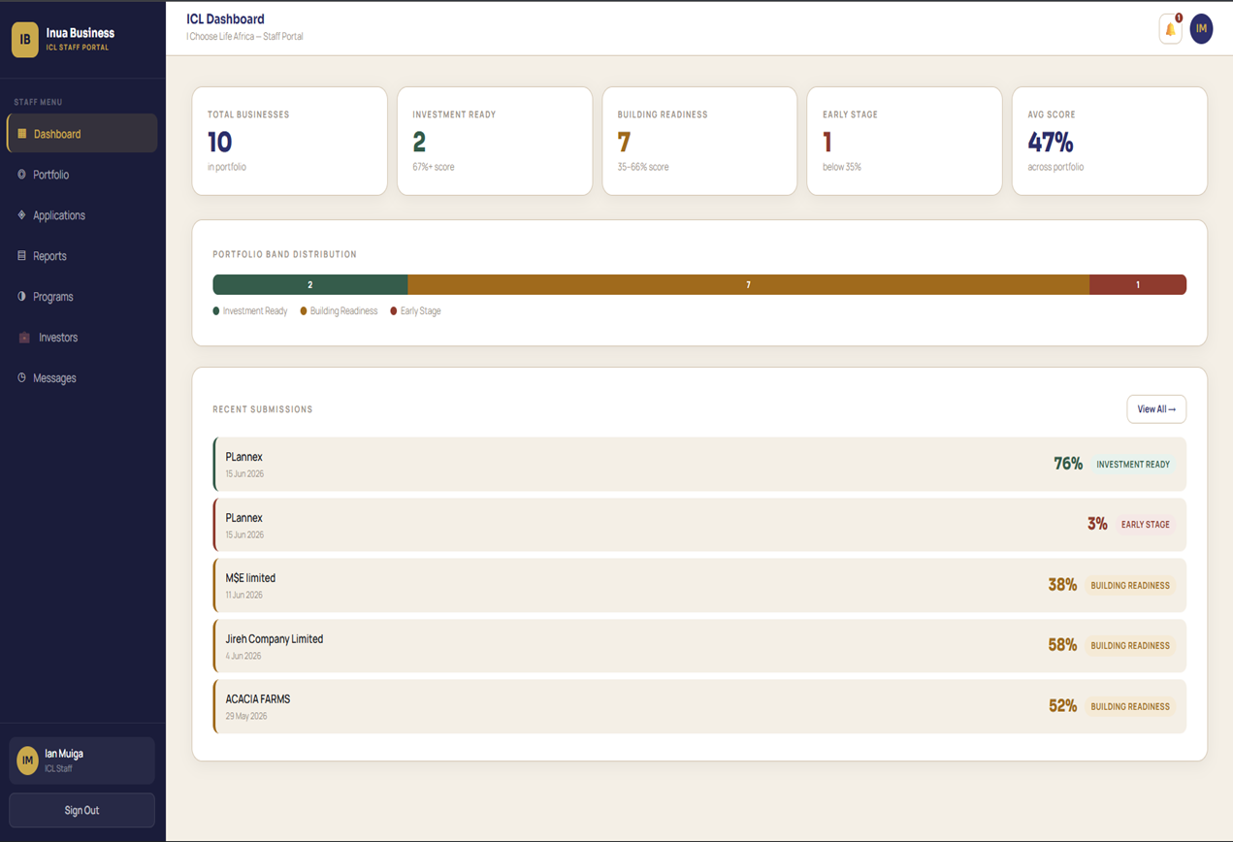
PRODUCT MVP
INUA Business
Turns Fragmented MSME data into standardized investor – ready profiles.
Personalized capacity building based on Assessment results
Building an ecosystem model instead of another financing platform
Creating intelligent data for institutions

Slide 6
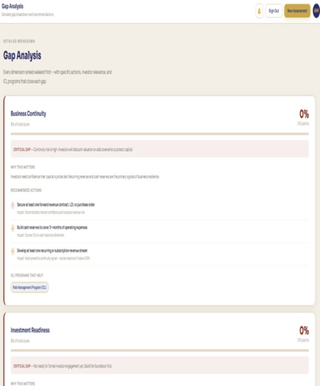
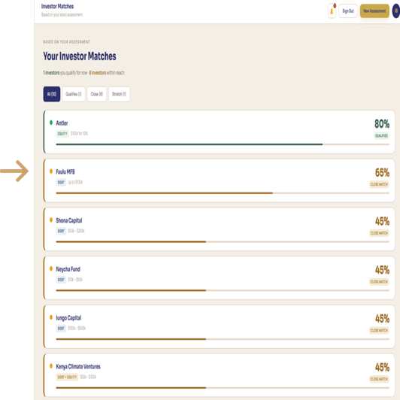
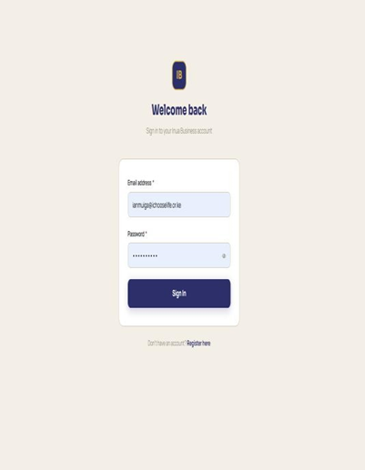

HOW IT WORKS
2
Get Your Score
3
Follow Your Roadmap
4
Access Network
1
Register & Assess
Detailed health report with category breakdown
Personalised training, compliance, and strategy
Connect to mentors, peers, and investors
Complete the 10-step business health questionnaire

Slide 7






MARKET OPPORTUNITY
7.4M
40%
$984M
MSMEs in Kenya
GDP Contribution
Kenya Startup Funding
MSME Policy 2025
KNBS / State Dept 2025
2025 — 32% of all African VC
Rwanda
→
Africa
Kenya
→
Uganda
→
Tanzania
→
→
Nigeria
East Africa is the continent's #1 investment region

Slide 8

WHY WE ARE DIFFERENT
WHAT EXISTS | WHAT IT DOES | WHAT’ MISSING
Consultants | Advice | Too expensive for MSMEs
Templates & Portals | Registration | No readiness diagnosis
Accelerators | Training | Not built for Kenya
Inua Business | All three- diagnosis + training +investor matching | Nothing missing
The White Space
No one else occupies this quadrant. Inua Business is the only platform combining:
Local Kenyan context
Full diagnostic platform
Compliance + training + network
One platform. Local context. Real investor pipeline

Slide 9
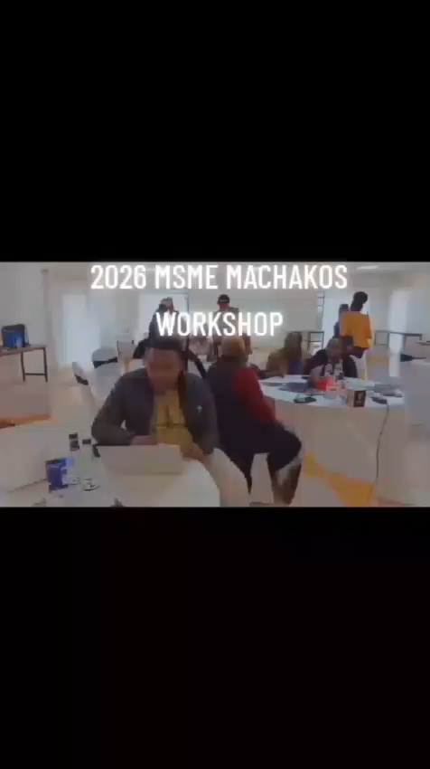
IN THE FIELD - MACHACKOS COUNTY
ICL Africa Business Training Program. Real MSMEs. Real Training. Real Impact
Through I Choose Life Africa’s MSME program, INUA gains access to existing MSME ecosystems for deployment and validation.

Slide 10
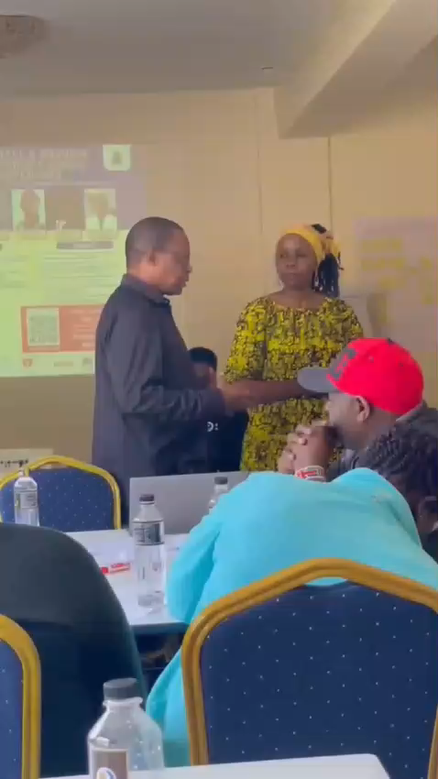
IN THE FIELD – LAIKIPIA COUNTY
From Laikipia To Machakos – This is National Reach

Slide 11



SOCIAL IMPACT
800K
31.4%
40% → 60%
55M+
New Jobs Created
Women-Owned
Government GDP Target
African SMEs
annually by Kenyan MSMEs
SMEs in Kenya
Inua Business is the tool
who need this infrastructure
Every business that survives employs someone.
Every business that grows changes a family.
SDG 1 – No Poverty
SDG 8 – Decent Work and Economic Growth
SDG 10 – Reduced Inequalities
SDG 17 – Partnerships for the Goals

Slide 12

REVENUE
BUSINESS MODEL
WHO PAYS INUA?
Service providers
Premium listings
Referral commissions
Institutions
Licensing fees
Institutional partnerships
Investors
Success fees on financing introductions
MSMEs
Premium Assessments
Subscription Services
Tier 3 — Scale
2027+
Tier 2 — Revenue
Q4 2026
Tier 1 — Foundation
Now
Phase one Capital Requirement
USD 69, 546
Covers MVP development, Pilot deployment and first commercial sales

Slide 13

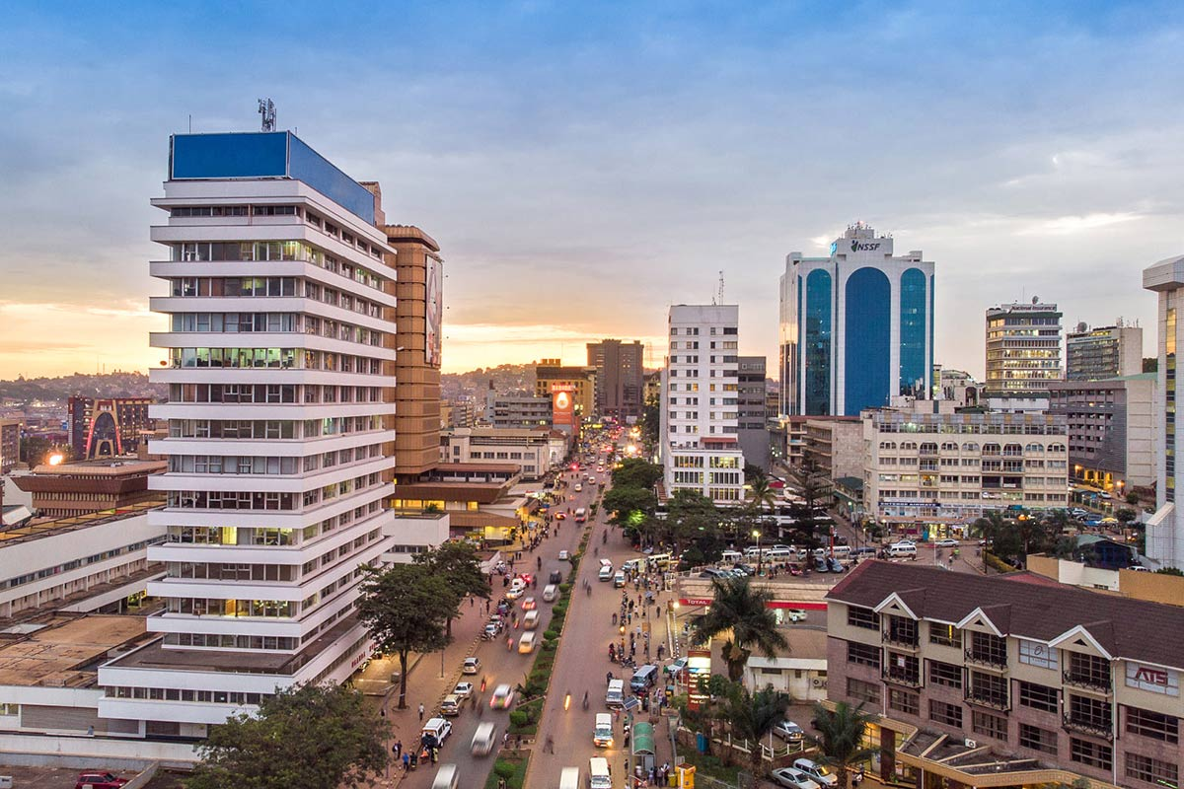
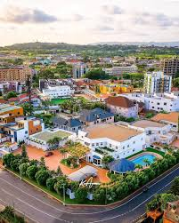


GROWTH
SCALING ROADMAP
2026
2027
2028
2029
2030
Kenya
East Africa
West Africa
SE Asia
Global
500
5,000
25,000
50,000
100K+
SMEs
SMEs
SMEs
SMEs
SMEs
MVP Live
4 Markets
6 Markets
10 Markets
Data Product
$0 Revenue
Sub Revenue
B2B Licences
Regional Scale
Intelligence
M-PESA started in Nairobi. It became the world's blueprint for mobile money.
Kenya's government targets MSME GDP: 40% → 60%. Inua Business is the infrastructure that gets them there.

Slide 14



Traction & Partnerships
ICL Africa
ASSEK
Kabarak University
Co-creator & Distribution Partner
Network & Community Layer
Research & Development Base
Kenya-wide SME reach and training infrastructure
Entrepreneur ecosystem access and peer network
Institutional credibility and academic rigor
134 Active Investors
Inua Business connects qualifying SMEs
in Kenya's equity and debt funding rounds (2024)
directly into this active investor pipeline
We did not build this alone. We built it with Kenya's leading SME institutions.

Slide 15

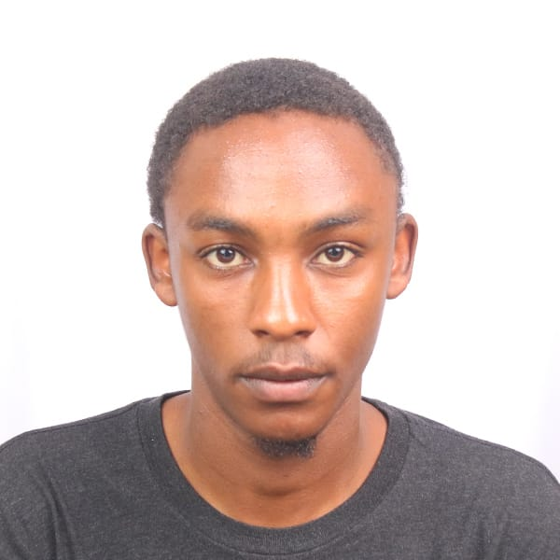
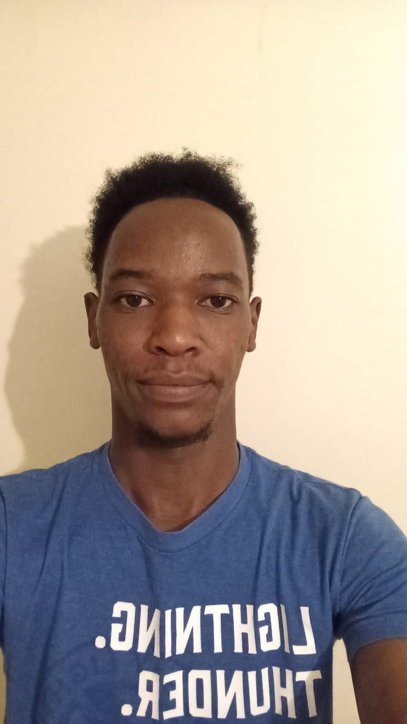

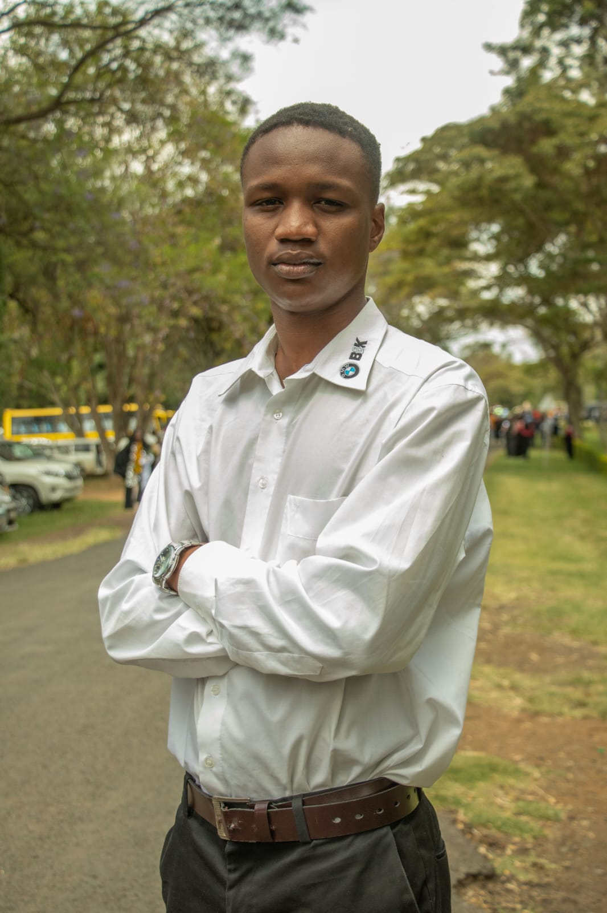


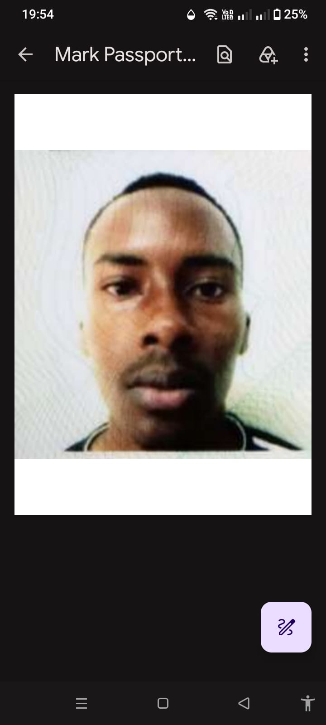
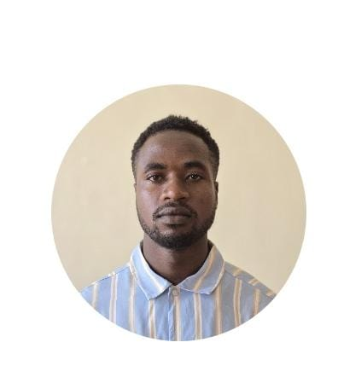
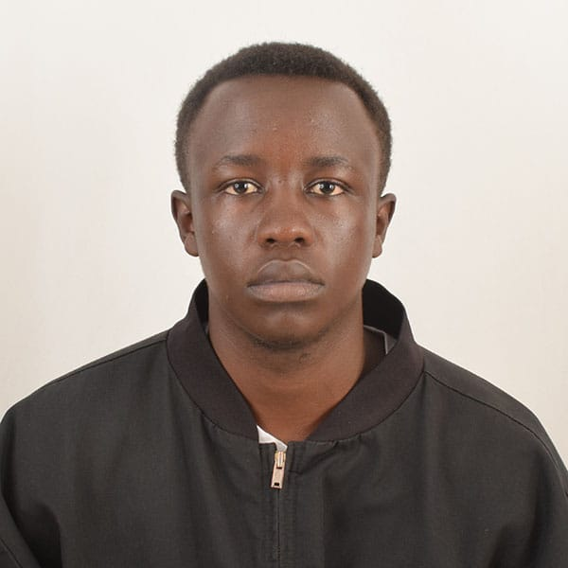
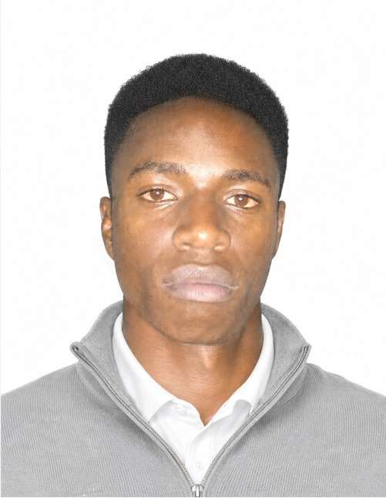
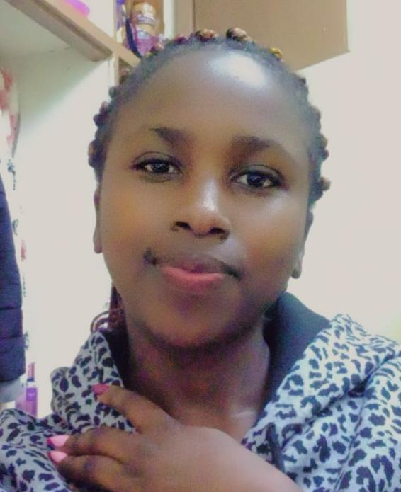
The Team
Allan Manthi
Michelle Akinyi
Kelvin Wanjiru
Mutai Victor
Faith Muthee.
Team Leader & CEO
Social impact & Community Outreach
Impact & Data Lead
Backend Developer
Business Strategy &Finance.
Ikasironi Brian
Marvin Mbugua
Mercy Jemeli
Mark Katabo
Aphiud Bosire
CTO
QA & DevOps
Operations & Compliance
Project Management
Frontend Developer

Slide 16

Inua transforms invisible MSMEs into investor-ready businesses
One platform to help SMEs survive, grow, and connect.
INUA BUSINESS
Diagnose. Grow. Connect.
THANKYOU
africa.pilcchina.org | Kabarak University | CICSIC Africa Division 2026

